Slide 1
The self-access center as a social landscape: the case of a Mexican self-access center
María del Rocío Domínguez Gaona
rocio_dominguez@uabc.edu.mx Myriam Romero Monteverde
romero.myriam@uabc.edu.mx
Jitka Crhová
jcrhova@uabc.edu.mx Language Department, Autonomous University of Baja California, México

Slide 2
Purpose
The purpose of this paper is to present a study about a Mexican self-access center using a framework provided by the the New Literacy Studies which allowed us to conceive the SAC as a social landscape.
This was an intent to describe the second language literacy practices that students were engaged in at the SAC

Slide 3
The New Literacy Studies
The NLS: a line of research that studies literacy as a social practice based on the view that reading and writing can only make sense if it is studied in the context of social and cultural practices (Gee, 2000)
Literacy : is a social practice. It is a way of making meaning with linguistic stuff in a communicative landscape (Pahl & Rowsell, 2012)
Literacy practices: are the general cultural ways of utilizing language which people draw upon their life (Barton and Hamilton, 2000).

Slide 4
Table 1 Basic elements of literacy events and practices (Hamilton, 2000, p. 17)
Elements visible within literacy events | Non-visible constituents of literacy practices
Participants: The people who can be seen interacting with the written text. Settings: The immediate physical circumstances in which the interaction takes place. Artifacts: The material tools and accessories that are involved in the interaction (including the texts) Activities: The actions performed by participants in the literacy event. | The hidden participants- other people, or groups of people involved in the social relationships of producing, interpreting, circulating and otherwise regulating written texts. The domain of the practice within which the event takes place and takes its sense and social purpose. All other resources brought to the literacy practice including non-material values, understandings, ways of thinking, feelings, skills and knowledge. Structured routines and pathways that facilitate or regulate actions; rules of appropriacy and eligibility – who does/doesn’t, can/ can’t engage in particular activities

Slide 5
Literacy practices in a self-access center
Elements visible within literacy events | Non-visible constituents of literacy practices
Participants: Students, tutors Settings: Defined by the underlying principles under which they are conceived. (technological resources, type of interaction that is expected Artifacts: materials, technology Activities: Activities of different nature (doing exercises, conversation sessions, tutoring). | The hidden participants: Administrators, teachers, materials designers The domain of the practice: language learning, and learning autonomy. All other resources brought to the literacy practice including non-material values, understandings, ways of thinking, feelings, skills and knowledge. Structured routines and pathways that facilitate or regulate actions: regulations of the SACs, expected routines, fixed pathways. rules of appropriacy and eligibility – who does/doesn’t, can/ can’t engage in particular activities

Slide 6
Data collection procedures
Documents revision: to understand structure and organization of the center
Interviews: teachers, tutors, administrator
Observations: 12 students (university Ss)
Analysis of interviews: Content analysis

Slide 7
Research question
How can we describe the self-access center from a social perspective?

Slide 8
Research site
A Mexican self-access center
Attendance was obligatory
University students: 60 % of users

Slide 9
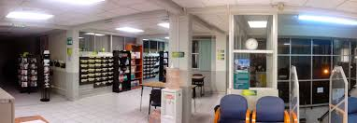

Slide 10
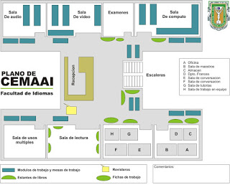

Slide 11
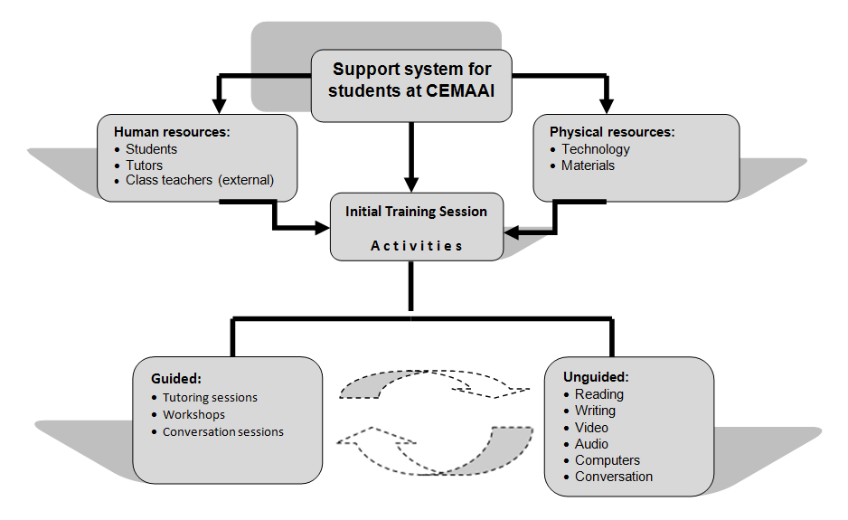
The plan of the center
Implicit design of CEMAAI (Domínguez-Gaona, López-Bonilla & Englander, 2012)

Slide 12
Policies that regulate the SAC
Regulated by internal and external institutional policies
The Secretariat of Public Education encouraged the implementation providing funding for equipment and training
The growth in the number of English language courses

Slide 13
Literacy events (an example of the Reading and Writing area)
Student | Level in English program | Attended Initial training session | Attended Tutoring Sessions | Artifacts used | Literacy events | Human (Staff) support | Time spent (minutes)
RW1 | 2^{nd.} | No | No | English course notebook | Completed written exercises requiring yes/no response | No | 30
RW2 | 2^{nd.} | Yes | No | English course notebook; Grammar worksheets; Cell phone translator | Completed grammatical exercises; Worked in a group; Corroborated answers with classmates. A teacher passing by helped him with an answer. | YES | 30
RW3 | 4^{th.} | No | No | Novel abridged and adapted with pictures; Dictionary | Read novel Consulted dictionary | No | 90
RW4 | 2^{nd.} | No | No | Game of Scrabble; Bilingual dictionary | Played game in Spanish; Formed 15 English words, all monosyllables | No | 30

Slide 14
The participants of the center (users)
Motivation to study the language: they have a vision of themselves as speakers of other languages, it is a a requirement to obtain their university diploma.
Selection of materials: They choose materials because they facilitate the development of language skills (75%) and to have a good time (33%)
Beliefs: how the language can be learned:
Reading aloud improves pronunciation:
“Well, when you are reading, for example, if you read aloud, well, you can practice… how do you say? Pronunciation.”, “…improve pronunciation and identify the difference between one word and another, and their meaning”.
If reading, vocabulary can be developed:
when you are reading and find words that you might have not seen in the vocabularies with the teachers and so you get a dictionary and you look them up, so that you increase [your vocabulary].”

Slide 15
Perception of the SAC by students:
Practice center
Part of the English course
Facilitates learning
Provides with numerous resources
Tutors are needed

Slide 16
The participants of the center: teachers/tutors
Tutors are visible participants
Guide students in the SAC (Sometimes they are invisible)
Teachers are invisible participants
Main factor to learn a language: practice (oral practice)
Autonomy: implies responsibility, decision making, self-development. It facilitates learning. They provided with ideas to develop it (strategies)
The SACs
Are innovative, useful and flexible
Provide students with many resources that support learning
Students need guidance
Tutors need more training

Slide 17
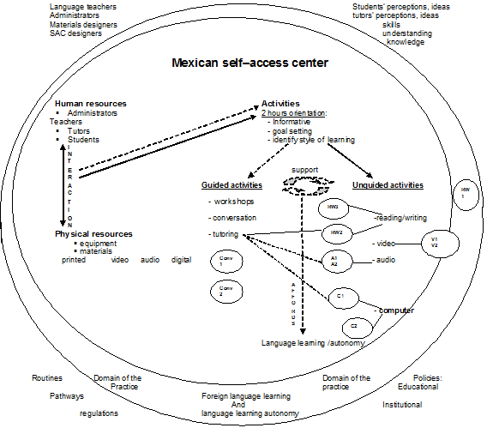
The social landscape of the SAC

Slide 18
Some conclusions
Data about this SAC allowed us to conceive it as a social landscape where visible and inferred elements interact to shape the literacy practices of this SAC which has its own particularities.
We could identify the relationship between the literacy events that the students performed and some inferred elements (the opinions and understandings of the students and teachers about the SAC, language learning and learning autonomy, policies, routines, language learning as the domain of the practice, and other participants).

Slide 19
This is the social setting in which university students of English participate in social interactions to learn a foreign language using the structure provided by the center in a flexible way, used at their convenience.
The center is perceived
as an ideal space to promote self-directed language learning,
as a facility that offers a lot of materials that promote language learning.
The main motivations of students to attend the center are policy-driven.
The practices in the center are shaped by the administrators, teachers and students’ decisions, beliefs, skills and knowledge.
We observed a social setting supported by self-directed learning in which
users and teachers need training,
materials should be revised
not all students fit in there because of their lack of self-regulation skills and lack of accompaniment

Slide 20
References
Barton, D., Hamilton, M. & Ivanic, R. (Eds.). (2000) Situated literacies. Reading and writing in context. New York: Routledge.
Benson, P. (2011). Teaching and Researching Language Learning. (2nd ed) UK: Routledge.
Cassany, D. (2005). Investigaciones y propuestas sobre literacidad actual: multiliteracidad, Internet y criticidad. Cátedra UNESCO para la lectura y la escritura. Santiago de Chile: Universidad de Chile.
Castillo Zaragoza, E. D. (2006) Centres de ressources pour l’apprentissage des langues au Mexique : représentations et pratiques déclarées de conseillers et d’apprenants. (Unpublished doctoral dissertation) Universiy of Nancy 2, CRAPEL. Nancy, France.
Castillo Zaragoza, E. D. (2011). Identity, Motivation and plurilingualism in self-Access centers. In G., Murray, X., Gao, & T. Lamb (Eds). Identity, motivation and autonomy in language learning. (pp. 91-106). Bristol, England: Multilingual Matters.
Chávez, M. (Ed.) (1999). Centros de autoacceso de lenguas extranjeras en México. México: UNAM.
Cooker, L., & Torpey, M. M. (2004). From the classroom to the self-access centre: a chronicle of learner-centred curriculum development. The Language Teacher, 28 (6), 11-16.

Slide 21
Domínguez, M.R. (1997). Proyecto del Centro de Medios de Auto-acceso de Idiomas. Tijuana B.C., México: Universidad Autónoma de Baja California.
Domínguez-Gaona, M. R., López-Bonilla, G., & Englander, K. (2012). Self-access materials: Their features and their selection in students’ literacy practices. Studies in Self-Access Learning Journal, 3(4), 465-481.
Dörnyei, Z. (2009). The L2 motivational self system. In Z. Dörnyei & E. Ushioda (Eds.), Motivation, language identity and the L2 self (pp. 9-42). Bristol: Multilingual Matters.
Gao, X. (2013). Internal conversation, agency and learner autonomy. ILAC Selections 5th Independent learning Association Conference 2012. New Zealand: Independent Learning Association.
Gardner, D., & Miller, L. (1999). Establishing self-access. UK: Cambridge University Press.
Gee, J. P. (1996). Social linguistics and literacies: Ideology in discourses. New York: Falmer
Dickinson, L. (1987). Self-instruction in Language learning. New York: Cambridge University Press.
Gee, J.P. (2000). The New Literacy Studies, from ‘socially situated’ to the work of the social. In D. Barton, M. Hamilton & R. Ivanic, (Eds.) Situated literacies. Reading and writing in context (pp.180-196). New York: Routledge.
Hamilton, M. (2000). Expanding the new literacy studies ; Using photographs to explore literacy as social practice. In D. Barton, M. Hamilton & R. Ivanic (Eds.), Situated literacies. Reading and writing in context. New York: Routledge.

Slide 22
Herrera, L.A. (2010). Self-access language learning. Students’ perceptions of and experiences within this new mode of learning. Xalapa, Veracruz, México: Universidad Veracruzana
Holec H. (1981). Autonomy and foreign language learning. Great Britain: Pergamon Press.
Holliday, A. (2002). Doing and writing research. London: Sage Publications.
Hubbard, P. (2007). Veinte años de formación de profesores universitarios de lenguas en México. Memorias de FEULE XVIII, Tijuana, México: UABC.
Jamison, S. (2007). Popular culture and literacy learning: negotiating meaning with everyday literacies (Published master dissertation). The Evergreen State College.
Koo Yew Lie, & Soo Hoo Pin Lick (2007). The social construction of literacy by Malaysian Chinese parents: perceptions of parents toward the language and literacy practices of two teenage children. The Reading Matrix, 7 (3), 72-87.

Slide 23
Lankshear, C. (1999). Literacy studies in education: disciplines developments in a post-disciplinary age. In M. Peters (Ed.), After the Disciplines. New York: Greenwood Press.
Logan, S. & Moore, N. (2004) Implementing learners training from a teacher’s perceptive. Proceedings of the Independent Learning Conference 2003. Melbourne, Australia: Independent Learning Association and he university of Melbourne.
Mayring, P. (2000, Junio). Qualitative content analysis. Forum Qualitative Social Research (On line Journa)l, 1 (2). Retrieved from http://www.qualitative-research.net/index.php/fqs/article/view/1089/2385%3E
Morrison, B. (2008). The role of the self-access center in the tertiary language learning process. System, 36, 123-140.
Pahl, K. & Rowsell, J, (2012). Literacy and education. London: Sage Publications
Plan de Trabajo CEMAAI (2003). Facultad de Idiomas, UABC.
Reglamento de CEMAAI (n.d.). Facultad de Idiomas, UABC.
Roswell, J. & Pahl, K. (2007). Sedimented identities in texts: Instances of practice. Reading Research Quarterly, 42 (3), 388-404.
Sheerin, S. (1997). An exploration of the relationship between self-access and independent learning. In P. Benson, & P. Voller, (Eds.). Autonomy and independence in language learning (pp.54-65). UK: Longman.
Skinner, E. N., & Hagood, M.C. (2008). Developing literate identities with English language learners through digital story telling. The Reading Matrix, 8, 12-38.
Sturtridge, G. (1992). Self-access – Preparation and Training. Manchester: The British Council.

